Slide 1
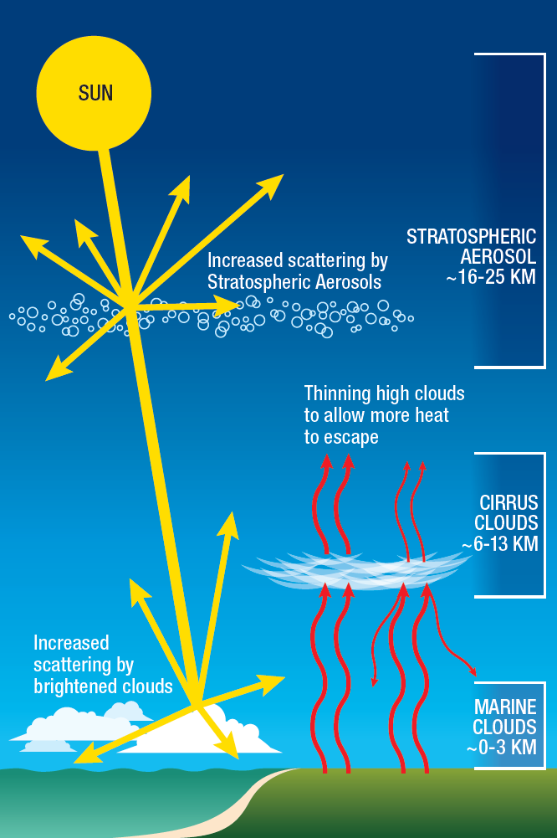
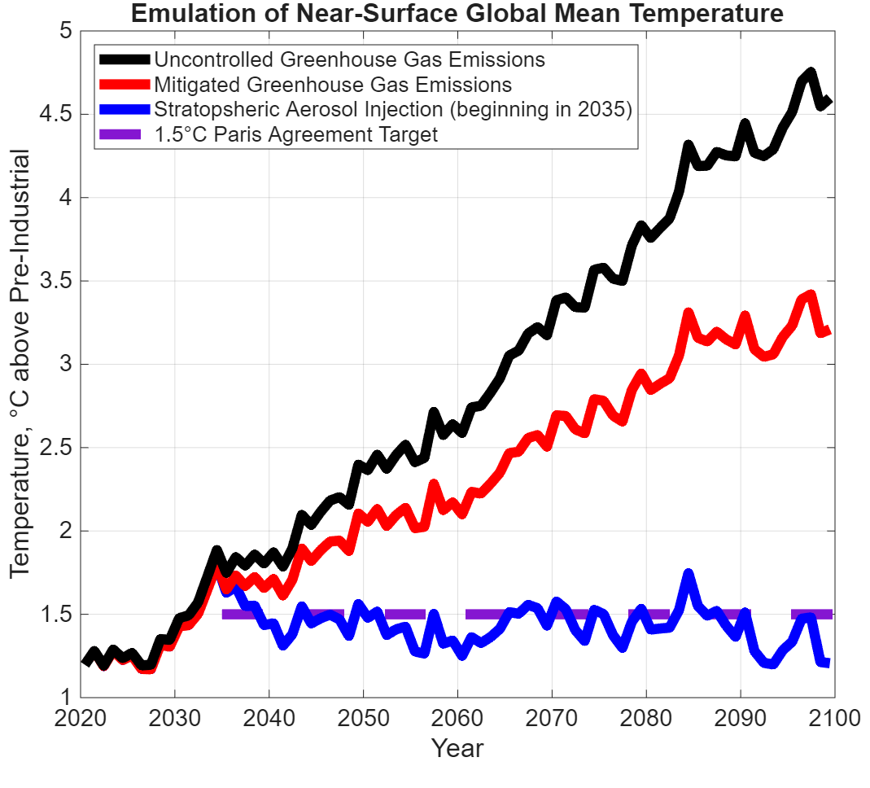
Stratospheric Aerosol Injection Emulation for Controller Design
Jared Farley^{[a][b]}, Benjamin Wagman^{[b]}, Tom Lowry^{[b]}
[a] Cornell University, Mechanical Engineering Ph.D., 2026
[b] 8931. Sandia National Laboratories/NM, U.S. Department of Energy
Context:
Greenhouse gas emissions raise global surface temperatures by trapping outgoing infrared radiation.
Stratospheric Aerosol Injection (SAI) cools surface temperatures by lofting droplets into the middle atmosphere and scattering incoming sunlight.
SAI studies often use a feedback controller to correctly set the amount and location of injection for a desired climate.
Earth System Models (ESMs) are often tedious or expensive to run, so coupling with a simpler model is desired for rapid or experimental controller design.
Results:
(National Academy of Sciences, 2021)
SAI feedback controller [1] [2] [3] coupled with the Climate Intervention Dynamical EmulatoR [4].
Variability from pre-industrial climate simulations superimposed on emulated forced response – feedback controller responds to both forced and unforced changes in temperature.
SAI maintains global mean temperature target, even in the presence of rising greenhouse gas concentrations.
Future work can rapidly prototype controller design before implementation in an ESM.
References:
[1] Kravitz, B., MacMartin, D. G., Mills, M. J., Richter, J. H., Tilmes, S., Lamarque, J.-F., Tribbia, J. J., and Vitt, F.: First simulations of designing stratospheric sulfate aerosol geoengineering to meet multiple simultaneous climate objectives, J. Geophys. Res.-Atmos., 122, 12616–12634, https://doi.org/10.1002/2017JD026874, 2017.
[2] MacMartin, D. G., B. Kravitz, S. Tilmes, J. H. Richter, M. J. Mills, J.-F. Lamarque, J. J. Tribbia, and F. Vitt, 2017: The climate response to stratospheric aerosol geoengineering can be tailored using multiple injection locations. J. Geophys. Res. Atmos., 122, 12 574–12 590, https://doi.org/10.1002/2017JD026868
[3] Richter, J. H., Visioni, D., MacMartin, D. G., Bailey, D. A., Rosenbloom, N., Dobbins, B., Lee, W. R., Tye, M., and Lamarque, J.-F.: Assessing Responses and Impacts of Solar climate intervention on the Earth system with stratospheric aerosol injection (ARISE-SAI): protocol and initial results from the first simulations, Geosci. Model Dev., 15, 8221–8243, https://doi.org/10.5194/gmd-15-8221-2022, 2022.
[4] Farley, J., MacMartin, D. G., Visioni, D., Kravitz, B., Bednarz, E., Duffey, A., and Henry, M.: A Climate Intervention Dynamical Emulator (CIDER) for Scenario Space Exploration, EGUsphere [preprint], https://doi.org/10.5194/egusphere-2025-1830, 2025.

